Slide 1


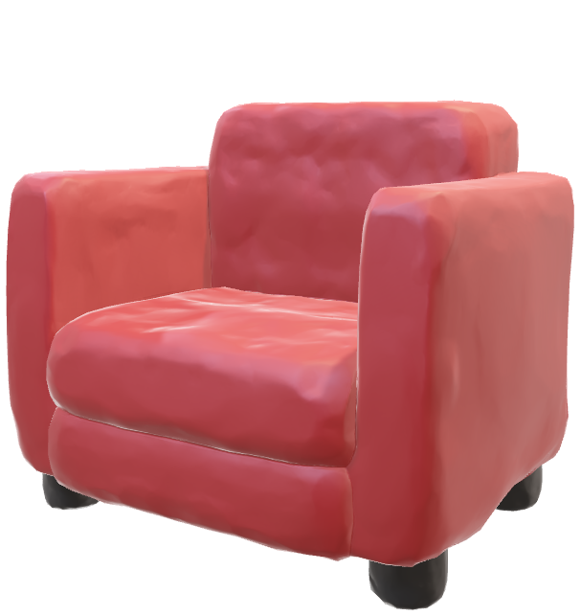

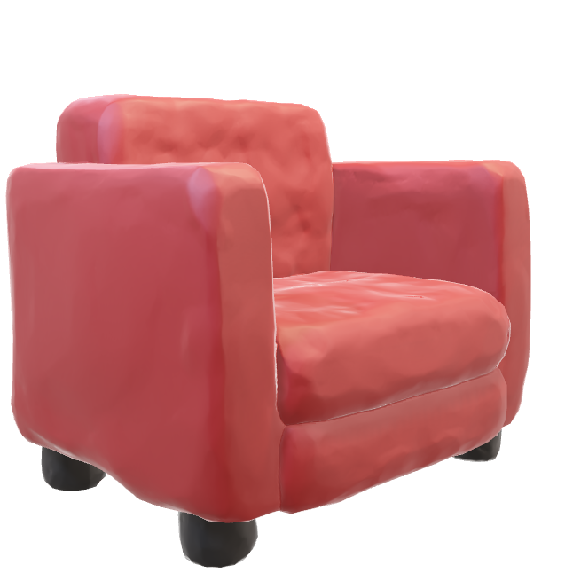
Chit Chat!
With Anjana .s

Slide 2

Anjana S (Interviewer)
Santhosh Yadav (mountaineer)

Slide 3
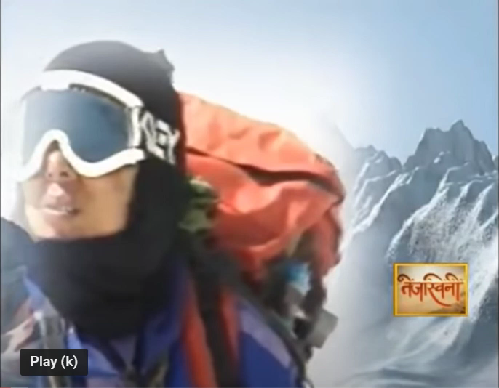

Slide 4
Anjana S (Interviewer)
Santhosh Yadav (mountaineer)

Slide 5
Anjana S (Interviewer)
Santhosh Yadav (mountaineer)

Slide 6
Anjana S (Interviewer)
Santhosh Yadav (mountaineer)

Slide 7
Anjana S (Interviewer)
Santhosh Yadav (mountaineer)

